Slide 1
Instructions for IEEE UV2026 Paper and Presentation Submission on EasyChair
Authors & Presenters
Contact: uv2026.conf@universal-village.org

Slide 2
Outline
Create EasyChair Account 【Slide 3】
Submit a New Paper 【Slide 11】
Update an Existing Submission 【Slide 15】
Check Review Results 【Slide 19】
[Important]Paper Submission Requirements 【Slide 23】
[Important]Paper Template 【Slide 24】
[Important]Formatting Requirements & Checklist 【Slide 25】
[Important]Forum & Competition Submissions 【Slide 26】
Contact InformationAccount Creation 【Slide 27】

Slide 3
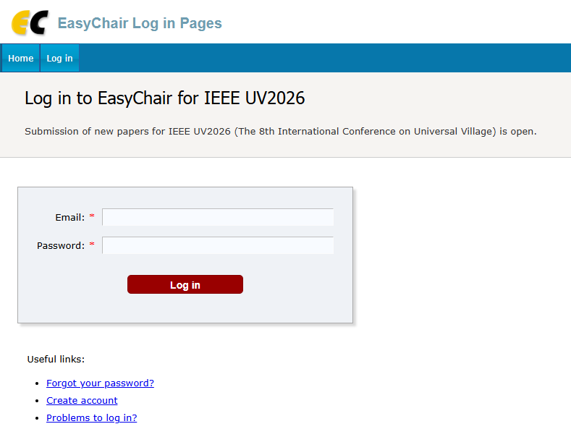
1. Create an EasyChair Account-1
a) Go to the EasyChair login page:
EasyChair: Log in （https://easychair.org/conferences/?conf=ieeeuv2026）
b) Click “Create account” to start the registration process.

Slide 4
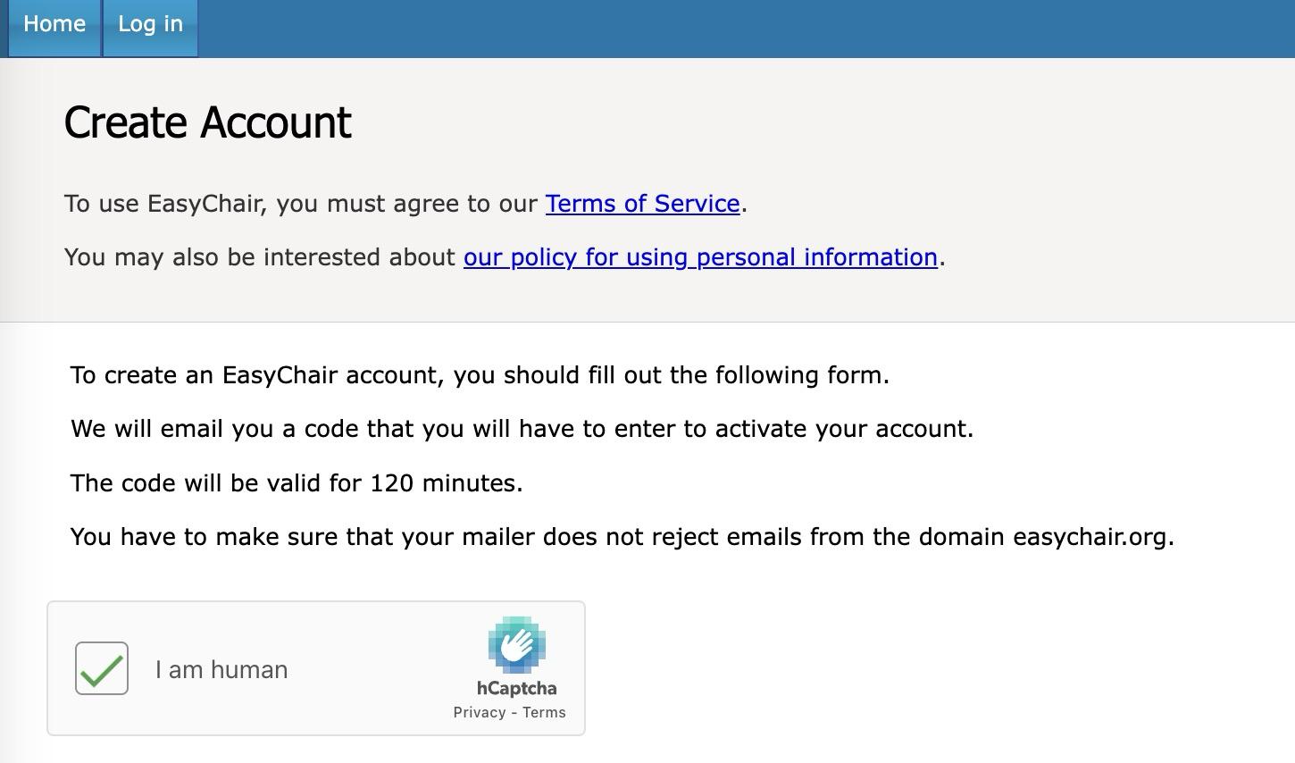
Create an EasyChair Account-2
c) Complete the human verification (reCAPTCHA) as required.

Slide 5
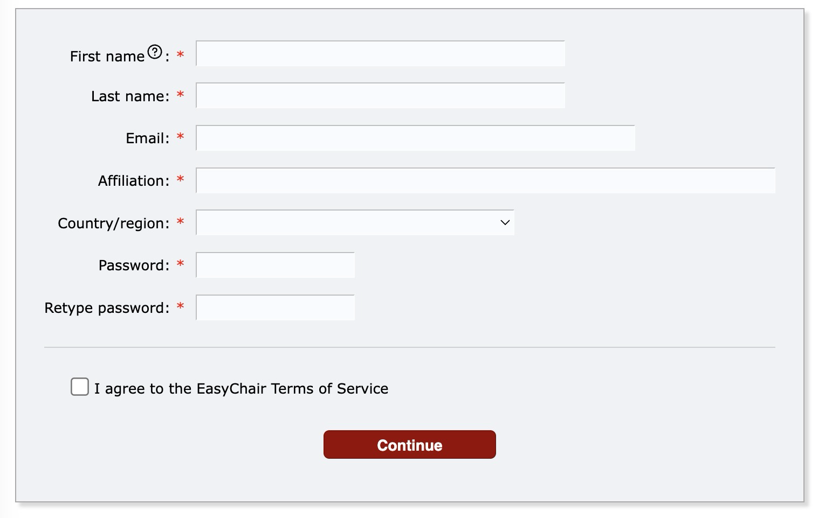
Create an EasyChair Account-3
d) Fill in your personal information in the registration form.

Slide 6
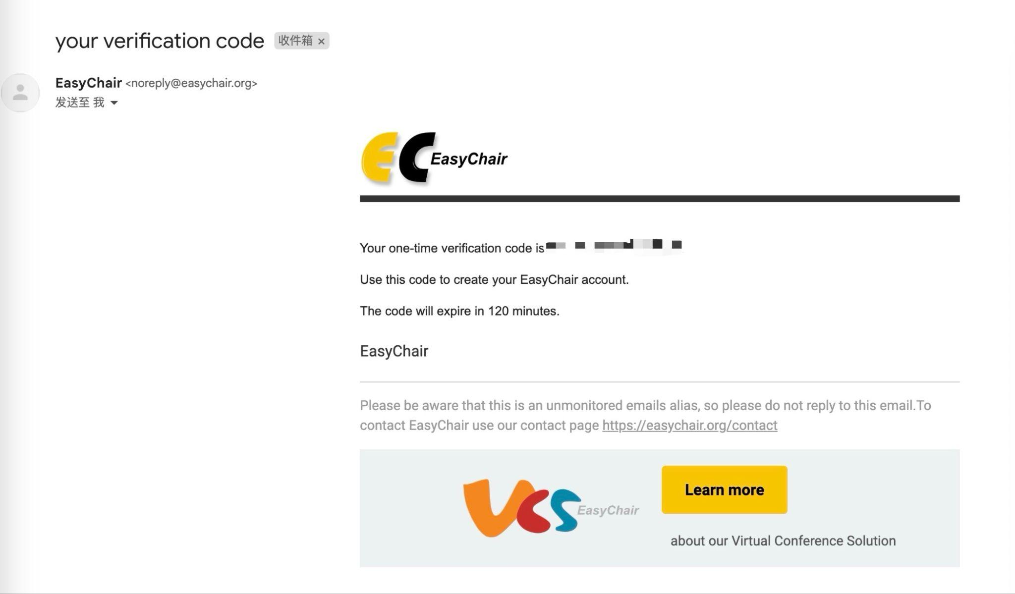
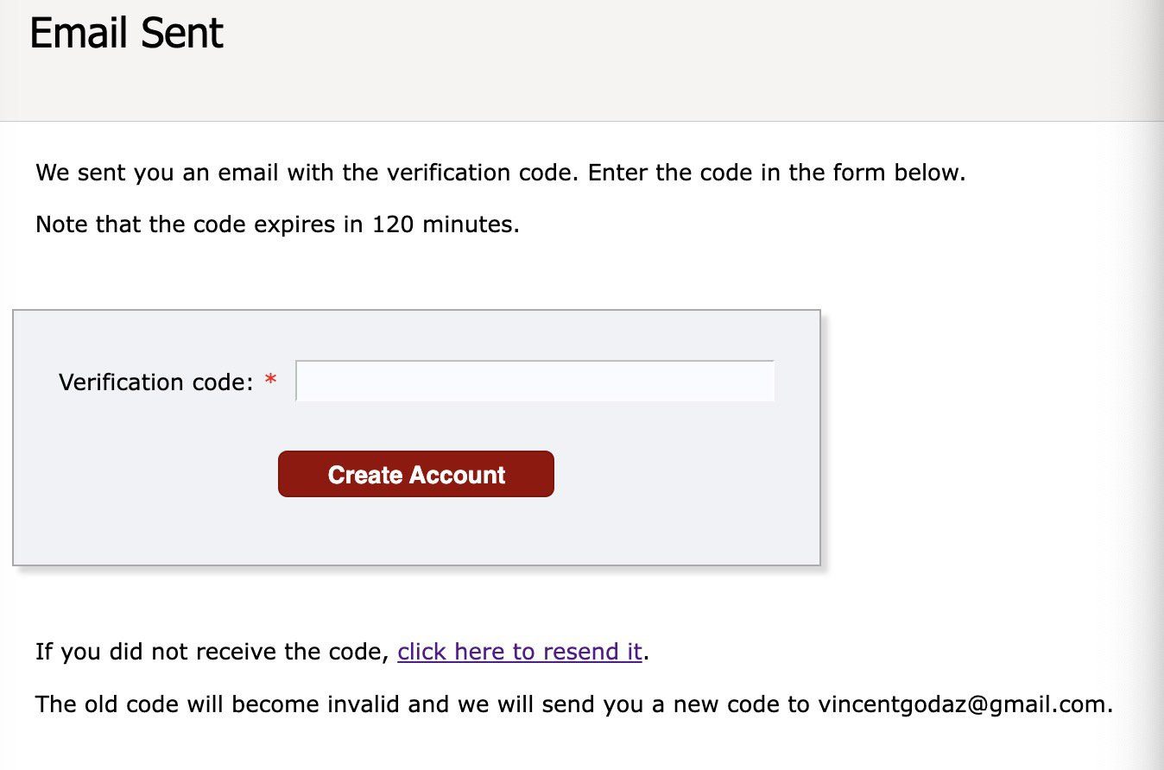
Create an EasyChair Account-4
e) After submitting the form, a confirmation message will be displayed, indicating that a verification email has been sent to your registered email address.
f) Check your email inbox for a verification message from EasyChair.
g) Enter the verification code provided in the email.
h) Click “Create account” to finalize your registration.

Slide 7
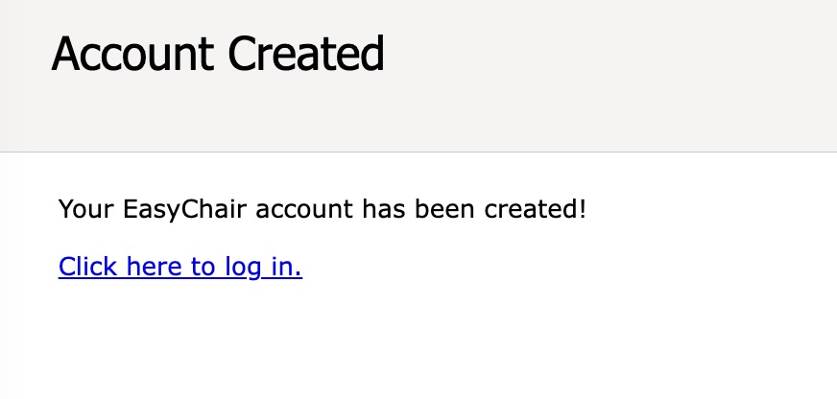
Create an EasyChair Account-5
i) Click the “Click here to log in” link to access the EasyChair login page.

Slide 8
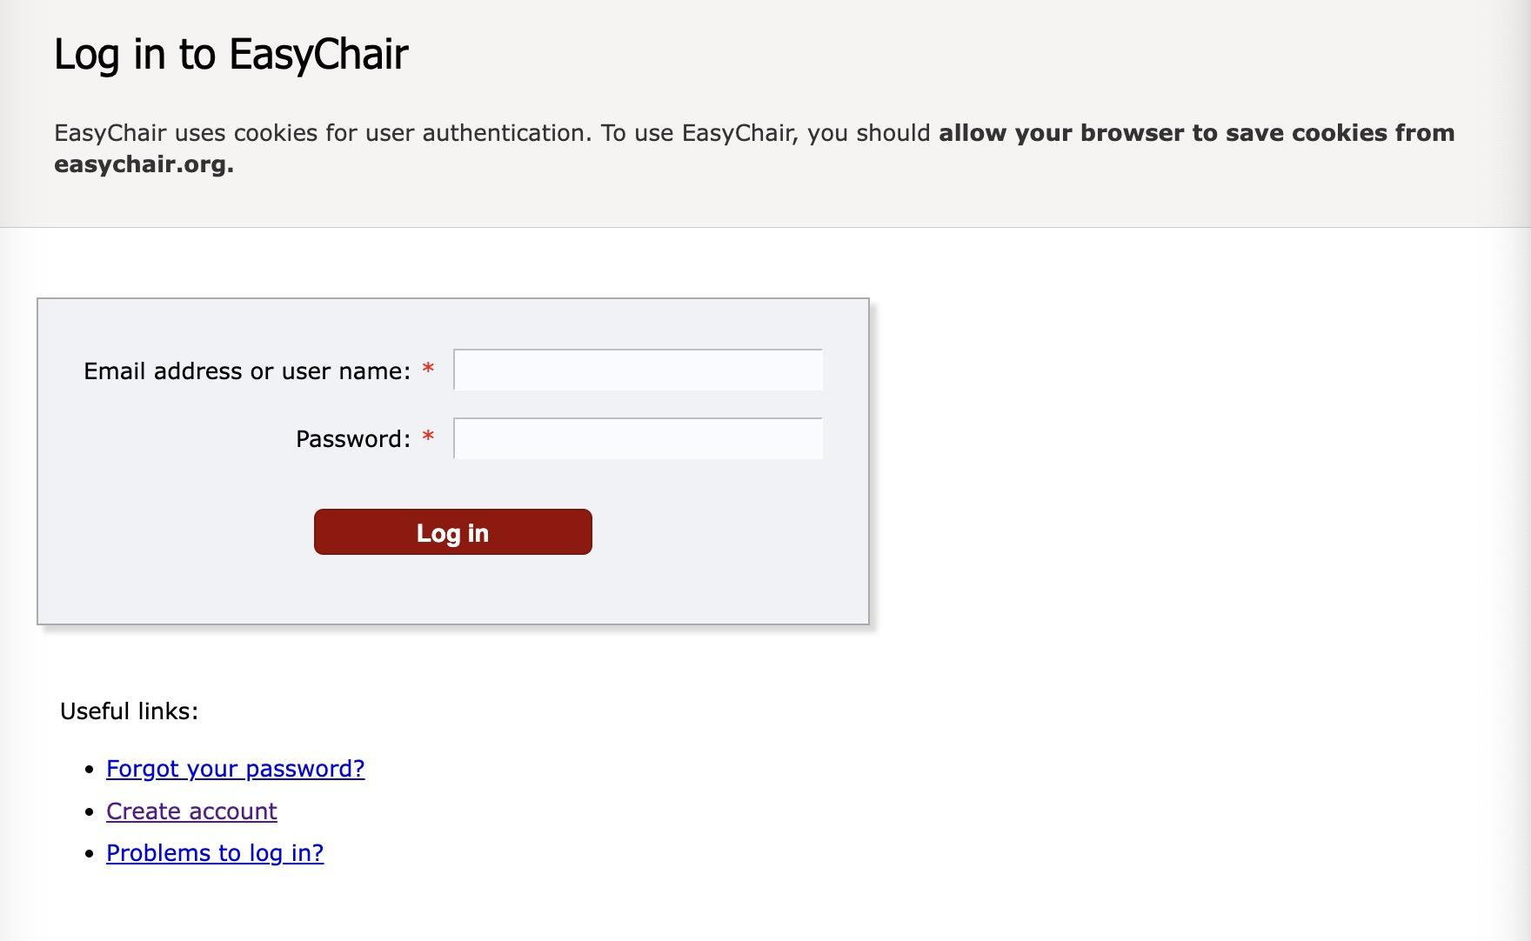
Create an EasyChair Account-6
j) You can now log in to EasyChair using your registered email address (or username) and password.
Log in （https://easychair.org/conferences/?conf=ieeeuv2026 ）

Slide 9

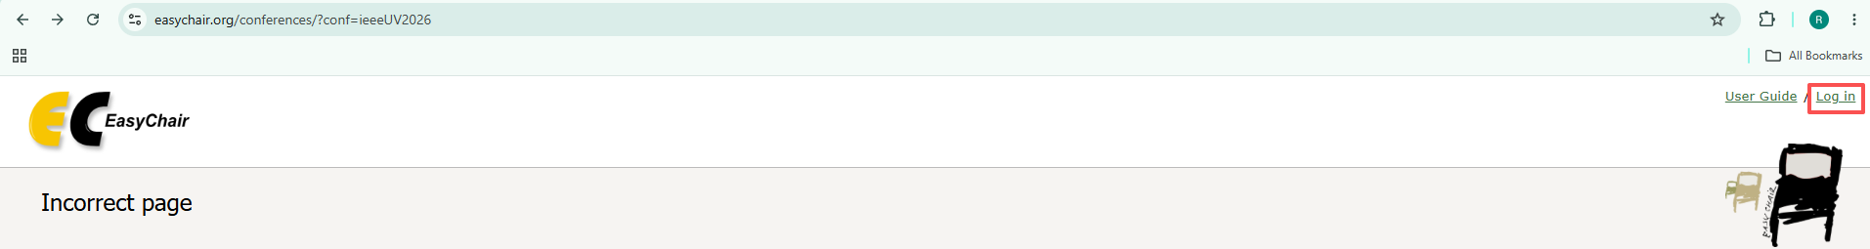
Create an EasyChair Account-7
Please make sure that you are logged in to EasyChair before accessing the IEEE UV2026 conference page (https://easychair.org/conferences/?conf=ieeeUV2026).
Otherwise, you may encounter the following error message.
Please click the “Log in” on the top right corner AND enter your account and password to log in.

Slide 10

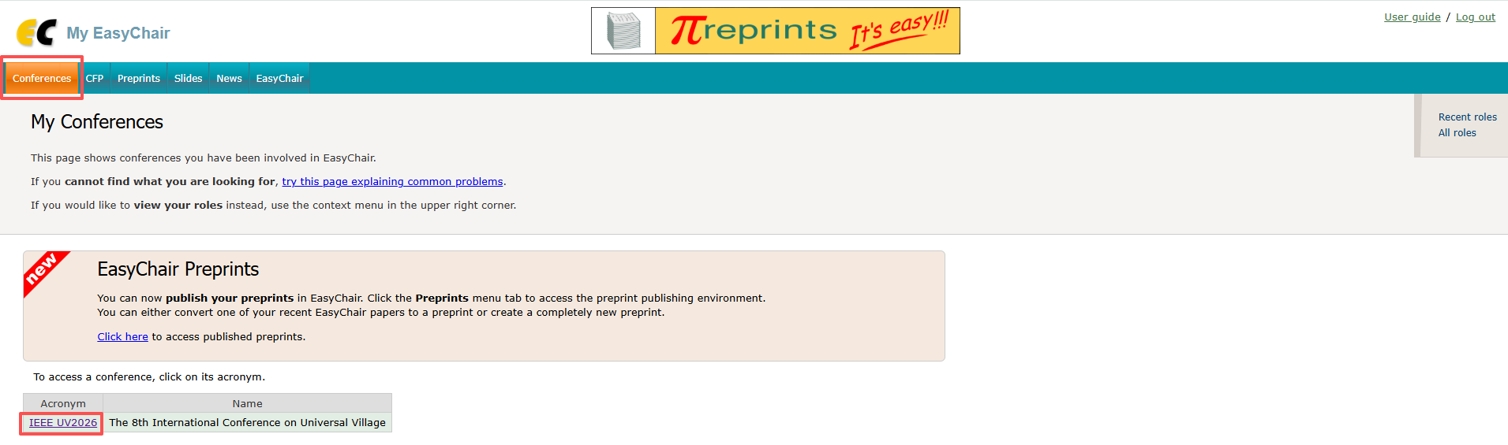

Create an EasyChair Account-8
b) After logging in, click on “Conferences” and then “IEEE UV2026” to access UV2026 Publication System

Slide 11
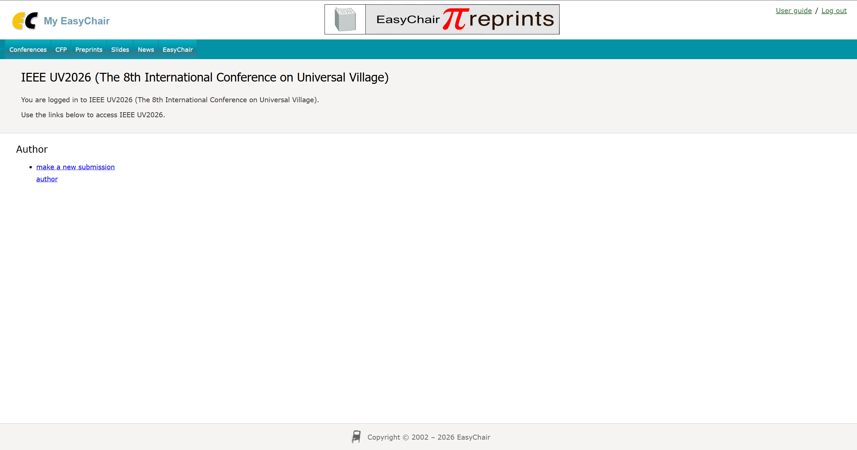
2. Submit a New Paper-1
a) Log in to EasyChair:
EasyChair: Log in (https://easychair.org/my2/conference?conf=ieeeuv2026)
b) Click “Make a new submission”.

Slide 12
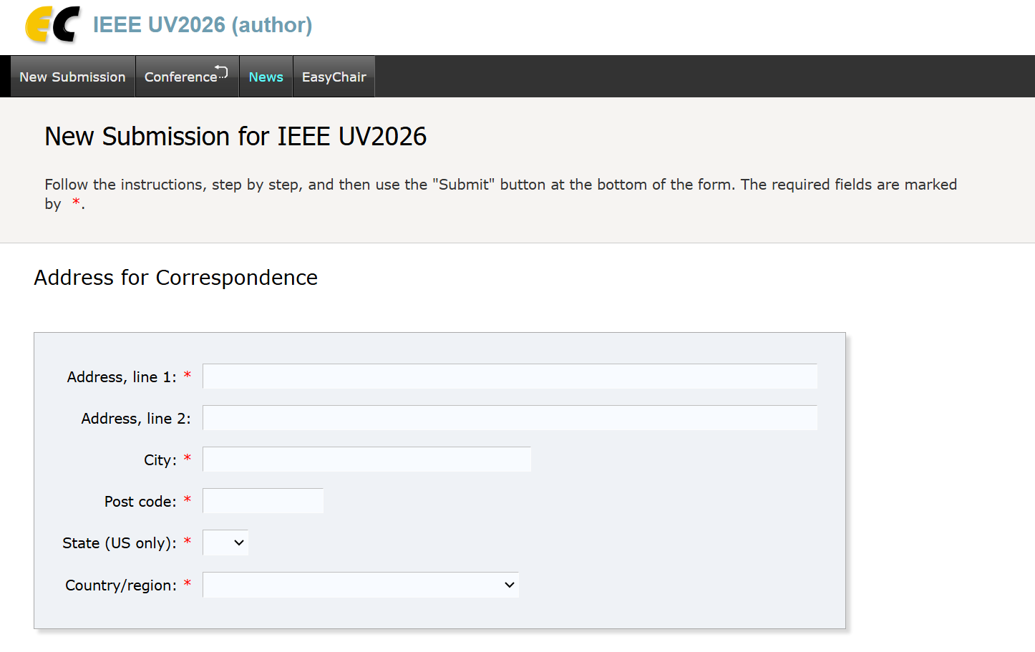
2. Submit a New Paper-2
c) Complete all required fields:
- Corresponding author information
- Author details
- Title and abstract
- Keywords
- File upload
d) Upload your manuscript as a PDF file.
[Important] All submissions MUST comply with the formatting and template requirements (See Sections 5–8).

Slide 13
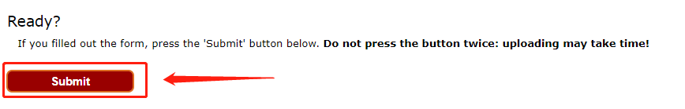
2. Submit a New Paper-3
e) Click “Submit” to finalize your submission.
[Important] Do not create multiple submissions for the same work. Use the update function for revisions (See Section 3).

Slide 14
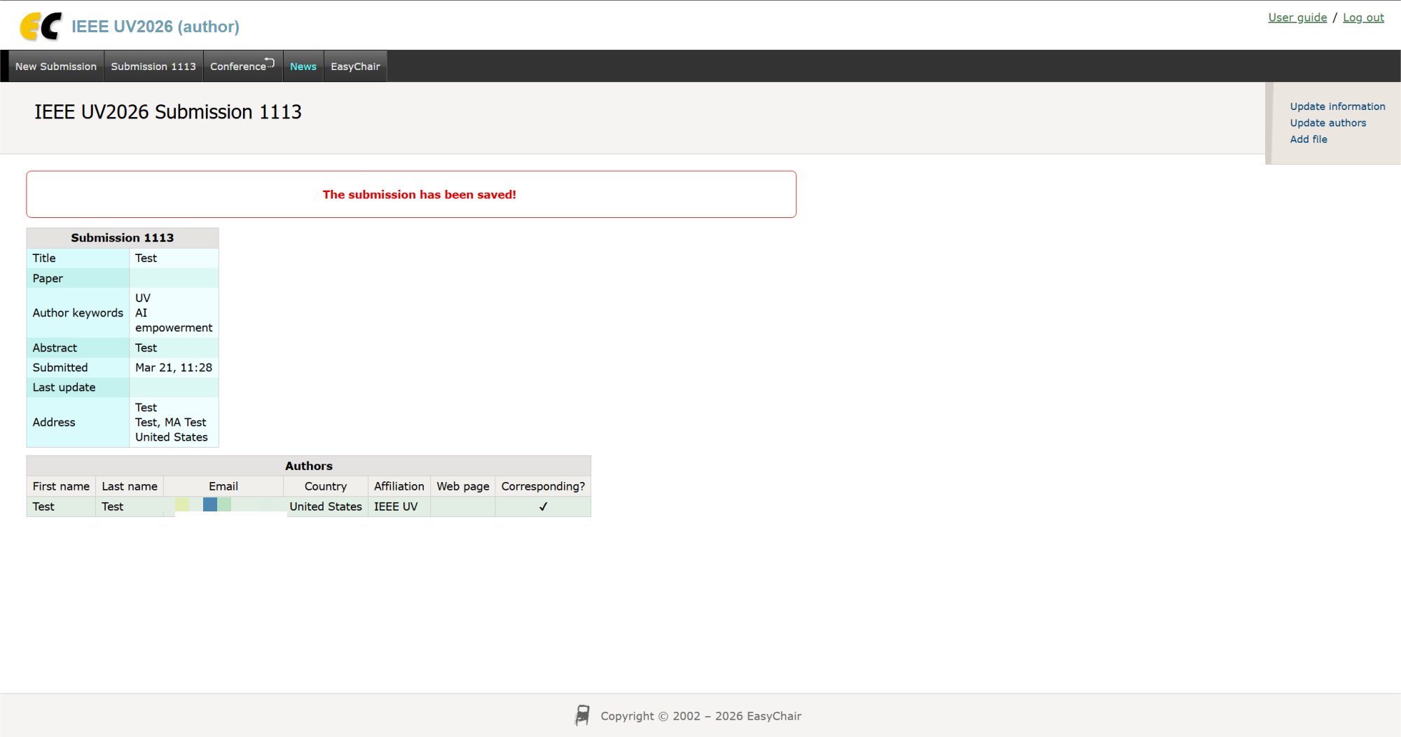
2. Submit a New Paper-4
f) Upon successful submission, the system will display your submission ID and details.

Slide 15
3. Update an Existing Submission-1
a) Log in to EasyChair.
EasyChair: Log in （https://easychair.org/conferences/?conf=ieeeuv2026）

Slide 16
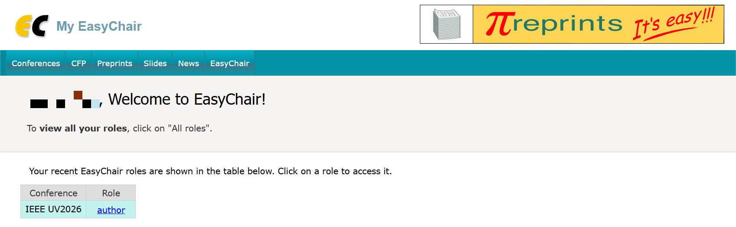
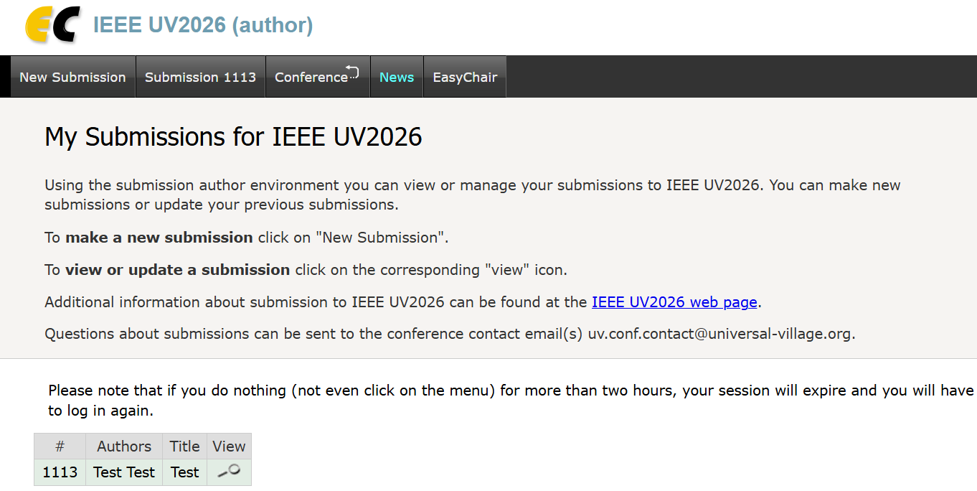

3. Update an Existing Submission-2
b) Select “Author” to access your submission dashboard.
c) Locate your submission and click the view icon

Slide 17
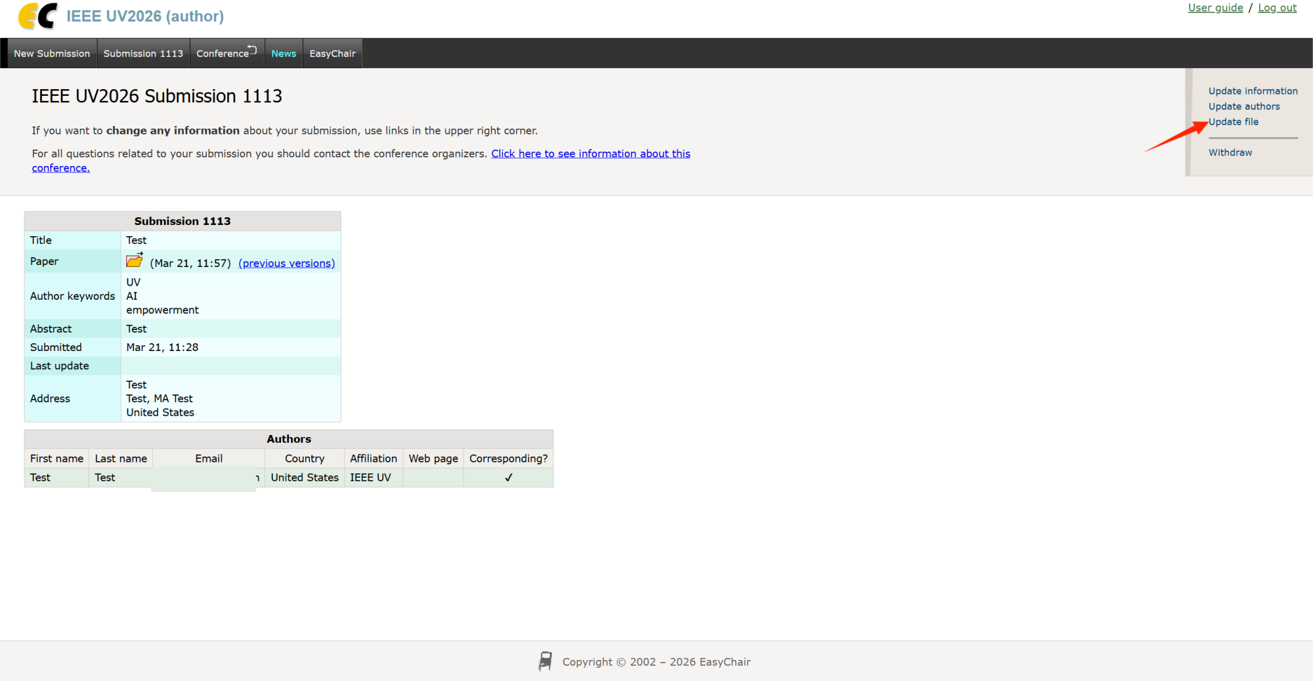
3. Update an Existing Submission-2
d) Click “Update file”.

Slide 18
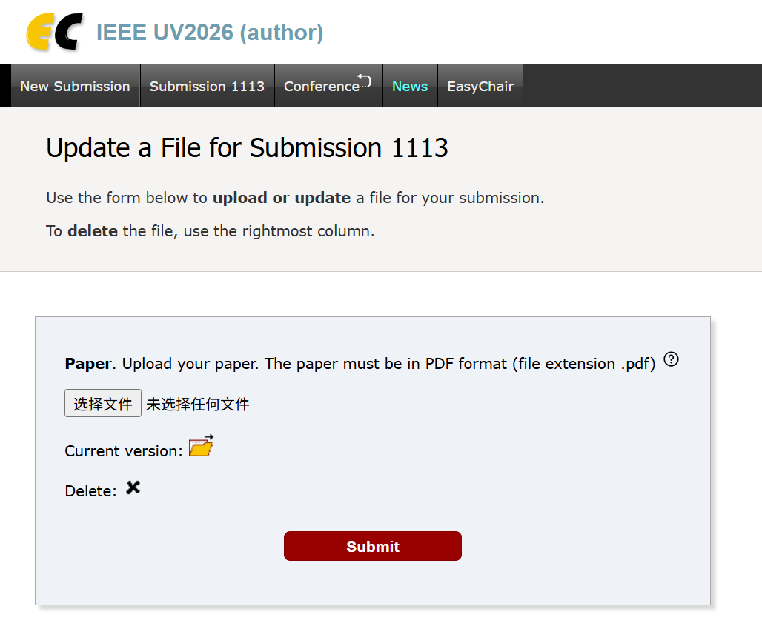
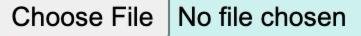
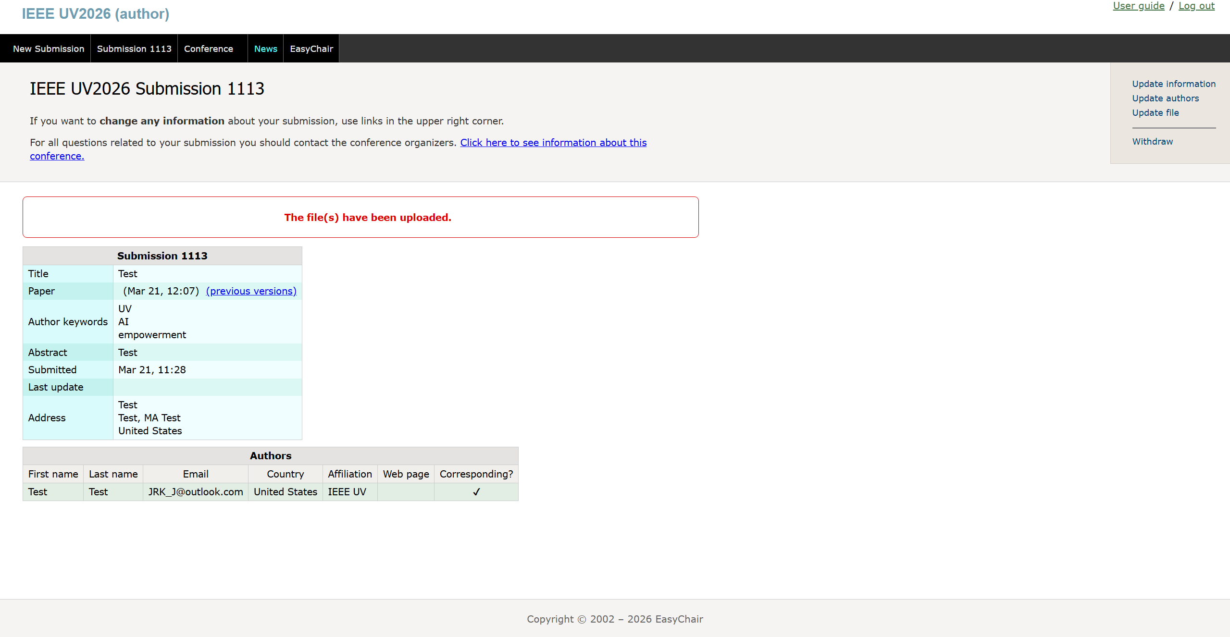
3. Update an Existing Submission-3
e) Upload the revised version of your submission.
f) Click “Submit” to confirm the update.
g) A confirmation message will indicate that the file has been successfully uploaded.
[Important] All submissions MUST comply with the formatting and template requirements (See Sections 5–8).

Slide 19
4. Check Review Results-1
a) Log in to EasyChair.
Log in （https://easychair.org/conferences/?conf=ieeeuv2026）

Slide 20
4. Check Review Results-2
b) Click “Author” to access your submissions.

Slide 21
4. Check Review Results-3
c) Select your submission and click the view icon .

Slide 22
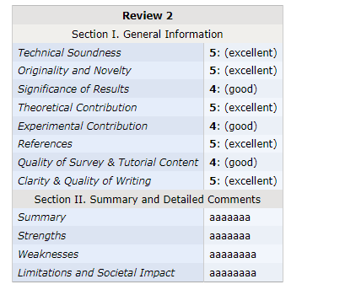
4. Check Review Results-4
d) Review the reviewer comments displayed on the page.

Slide 23
5. Paper Submission Requirements
For Paper Submissions [TS1 – TS12]:
Paper Types:
Short Papers: 3–4 pages
Regular Papers: 5–8 pages
Requirements:
Submit one PDF file (US Letter format, not A4)
Include an abstract (100–300 words)

Slide 24
6. Paper Template
All submissions MUST use the IEEE two-column template:
UV2026 Resources:
UV2026 LaTeX Template
https://drive.google.com/file/d/1giCI-NQoTDp-InrzXmdmsPOaIqIjhilt/view
Overleaf Guide (for First-Time Users)
https://docs.google.com/document/d/14sOtRU2KhsCSTBiIJZ2LAXMBtu4fAosj/edit
LaTeX Instructions (IEEEtran Guide):
http://www.ctan.org/tex-archive/macros/latex/contrib/IEEEtran/IEEEtran_HOWTO.pdf

Slide 25
7. Formatting Requirements & Checklist
IEEE Compliance
All submissions MUST comply with IEEE formatting standards:
Use the IEEE two-column format
Embed all fonts in the PDF
Remove headers, footers, and page numbers
Do not underline URLs or email addresses
Detailed guidelines:
https://standards.ieee.org/content/dam/ieee-standards/standards/web/documents/other/embeddedfonts.pdf
Submission Checklist
Before submission, please ensure:
The paper follows IEEE format
All fonts are embedded in the PDF
Figures and tables are clear and readable
References follow IEEE citation style
[IEEE UV2026] Format & Font Error Checklist https://docs.google.com/document/d/1QnzxN1ThMlvL_A9SyiQ_TOT4-vhXnC36/edit?usp=sharing&ouid=109822557424734033356&rtpof=true&sd=true

Slide 26
8. Forum & Competition Submissions
Applicable Tracks: [CF][SF][AF][DSC][MC][PC][K12C]
Submission Requirements
All submissions must include:
An abstract (100–300 words)
Presentation slides (5–20 pages, PDF or PowerPoint)
Additional Requirements (Competitions Only)
For Data Science Competition (DSC) and Modeling Competition (MC):
A full paper
Supporting materials (e.g. code, video demonstrations)
Acceptance Policy
For accepted submissions:
At least one author must register for IEEE UV2026
Authors must submit presentation slides (PDF/PPT)
The work must be presented at the conference

Slide 27
For any submission-related inquiries:
uv2026.conf@universal-village.org
9. Contact Information Account Creation

